Slide 1

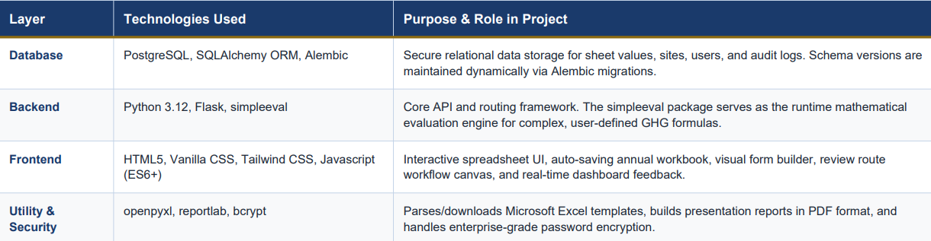
DIGITAL GHG INVENTORY SYSTEM
SHATAM RAI

Slide 2
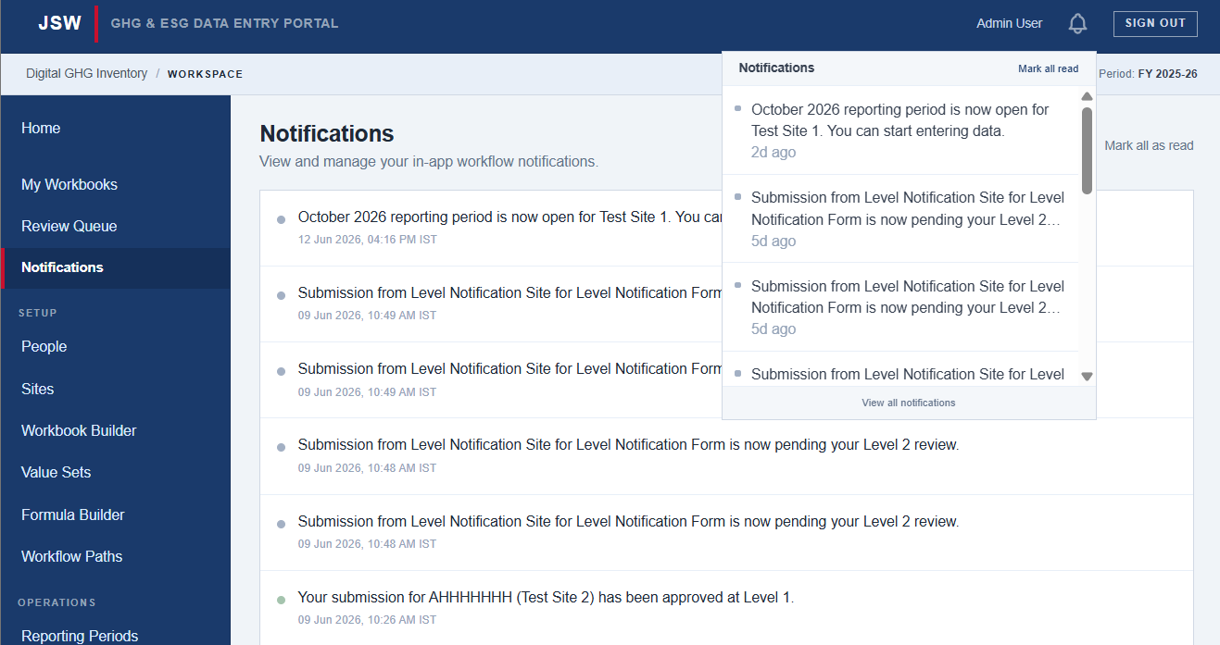
MODULES IMPLEMENTED
Notification Engine
Dispatches event-driven in-app alerts to minimize reporting delays. It alerts SPOCs instantly when a sheet is sent back for corrections, feeds a navigation bell widget with direct links, and maintains a notification history dashboard for sustainability officers. Notifications are manually tested and work even on multi approval levels and change requests/rejections.

Slide 3
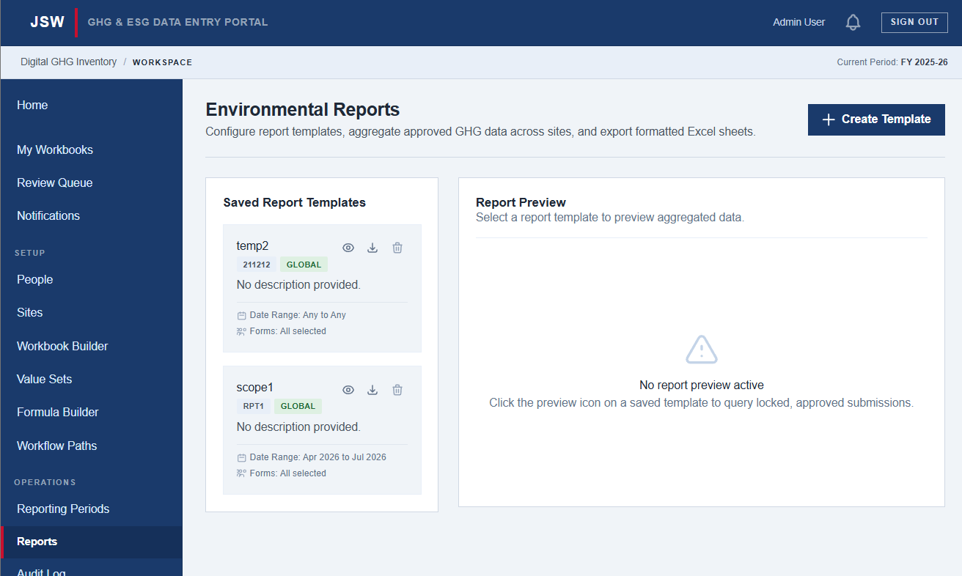
MODULES IMPLEMENTED
Report Builder
Aggregates activity data and resolves Scope 1, 2, and 3 emissions equations in a sandboxed calculation engine. It generates structured Excel sheets and landscape PDF reports for corporate disclosures, displaying real-time calculation previews alongside final approved reportable values.

Slide 4
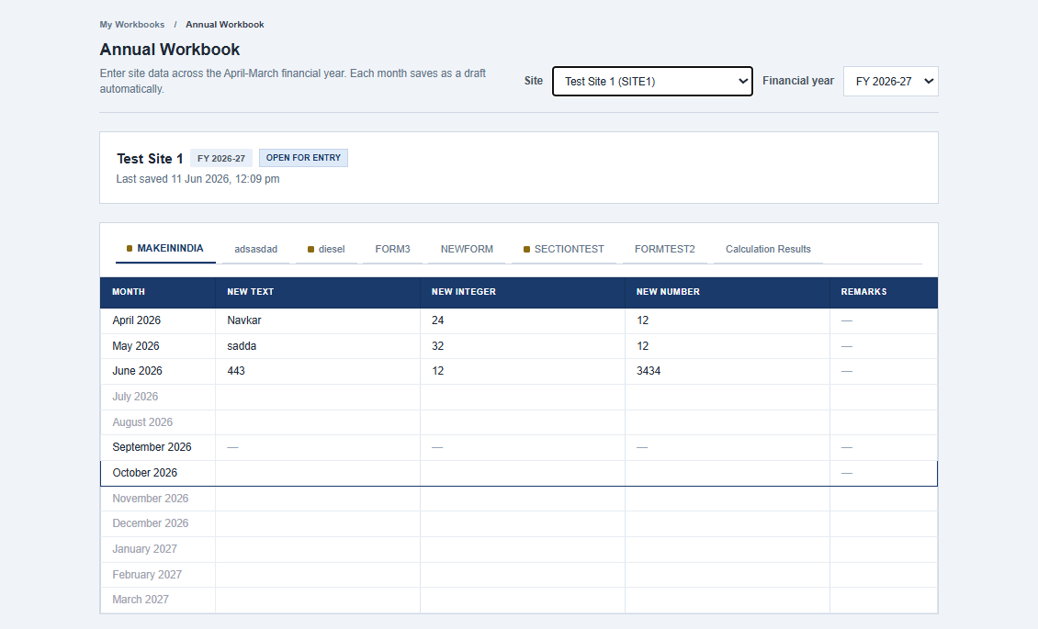
MODULES IMPLEMENTED
Designing SPOC Sheets
The SPOC Sheet module is the main data entry interface where users enter monthly facility metrics. It presents an Excel-like grid styled with JSW Steel's color scheme, showing a white background and a blue left border on the month cell for the active reporting period. Month cells are color-coded to indicate their status, such as drafts or submitted sheets, using a dark font for high contrast. The tabs are arranged in a clean, scrollable single row with 8px status dots that show when a sheet is a draft or needs correction.

Slide 5
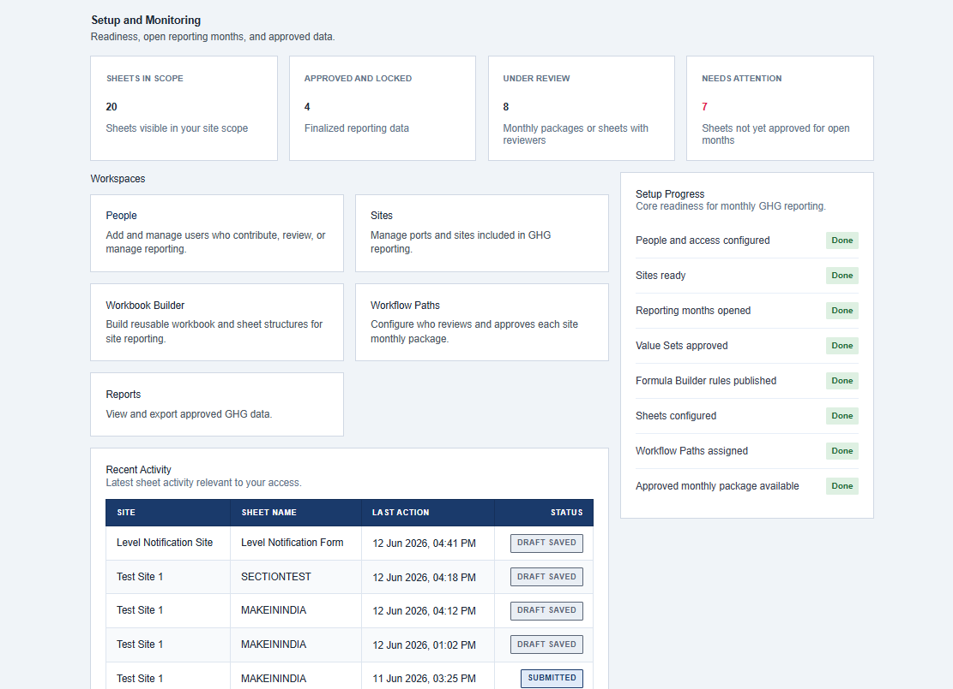
MODULES IMPLEMENTED
Designing Dashboard Widgets
As all archetypes (SPOC, Approver, Admin, superadmin etc.) in this application are treated as users, creating separate dashboards for different archetypes was nearly impossible. Hence dashboard was designed as an ensemble of different widgets which appear based on the permissions user has been given. Example : View Pending Approvals widget will only appear in the user who has approval permissions.

